Slide 1


Stockia
Direktions
Stock Markets
Reduce Risks
Predictions
Improve Profitability
Stock Prediction Services
(Current Product)
Cryptia
Crypto / Digital Currency Predictions Services
(upcoming Products)
Notes:
Dear Ladies & Gentlemen Welcome to our Presentation

Slide 2




Dr. Ayaz H. Khan
Founder & CEO
Received his MS from LUMS and PhD from KFUPM with specialization in High-end Computing. He has more than 15 year experience in Industry and Academia
https://direktions.net
Dr. Salman A. Khan
Co-founder & CTO
Received his BS and MS from KFUPM and PhD from University of Pretoria with specialization in Artificial Intelligence. He has more than 20 years experience in Research and Academia in international universities.
Mr. Rashid A. Khan
Director, GRC & Business Development
Holds a BS in Computer Science. He has more than 15 years experience in the Middle East in IT Business Development and IT risk management.
Mr. Murad Ali
COO
Received his MS with specialization in data science. He has more than 15 year experience in the IT industry and in different roles and currently works as Technical Head in Pakistan Revenue Automation Ltd. (FBR)

Slide 3
MISSION
COMMITTED TO REDUCE INVESTORS RISK AND IMPROVE INVESTMENT RETURNS
Historical Data
News Feed
Investment Return
The aspiration of any investor is to forecast the market behavior aiming the best decision when it comes to buying or selling shares of stocks seeking to maximize His/her profits
Notes:
We are committed to offer a prediction service that will guide Investor to maximize investor returns and minimize the risks by using Historical Data for trend analysis and current news for market speculation.

Slide 4
PROBLEM
Efficient Market Hypothesis (EMH) is a back-breaker for forecasters. In its crudest form, it effectively says that the returns from speculative assets are unforecastable.
We, humans are not designed to analyze huge set of data from multiple sources for rational decision making.
Notes:
The real challenge is to predict future financial Assets Price value or its trend , the only way is to analyze huge amount of data integrating with the current Market speculation by going through such news / website , Humanly it not possible on day-to-day basis.

Slide 5
OPPORTUNITY
Satisfactory , sophisticated and automatic Prediction & Forecast mechanism (SaaS Based Model – Subscription Service ) with
Deep Analysis Capability
Semantic Analysis Capability
AI enabled
to generate Long term & Short term predictions for Investors saving their time , efforts and energy.
Notes:
Technology enabled us the capability for Deep and Semantic analysis using ML/AI model to predict price value of Financial Asset.

Slide 6
VALUE PROPOSITION
360 Degree Markets Analysis
Enhanced Profit Margin on Investment.
Long Term and Short Term Predictions.
Predict most favorable options
Machine Learning Model
Multiple Market Options based on dataset feed
Notes:
Our Product offers complete Market Analysis and provide more favorable options to maximize Investment Return using ML model. The benefit of our developed model is that it can be applied to multiple markets, such as Pakistan Stock Exchange, Bombay Stock Exchange, Tadawul etc., depending on data feed to Model.

Slide 7
PRODUCTS
Current Product : Stockia
Our Product Stockia is an Advisory service for generating long term and short term signals for PSX investors.
Upcoming Product : Cryptia
Our upcoming product Cryptia is an Advisory service for generating prediction for Crypto Currencies investors.
Notes:
We Offer two different product : Stockia & Cryptia , Stockia is for Stock Market. Currently the data feed used is for Pakistan Stock Exchange. The product has the capability to predict based on Data Feed. For example, if Tadawul or any other data set feed to model it will predict accordingly. Our 2nd product is Cryptia for Digital Currencies prediction , it is different model designed for Crytpto currencies .

Slide 8
TECHNOLOGY STACK
MICROSERVICES ARCHITECTURE
AI BASED SIGNALS PREDICTION
AUTOMATED DATA EXTRACTION AND PROCESSING
AUTOMATED SENTIMENT ANALYSIS BASED ON NEWS DATA
CUSTOMIZABLE AND SCALABLE DATA SOURCES
Notes:
Technology Stack MICROSERVICES ARCHITECTURE , AI BASED SIGNALS PREDICTION
AUTOMATED DATA EXTRACTION AND PROCESSING
AUTOMATED SENTIMENT ANALYSIS BASED ON NEWS DATA
CUSTOMIZABLE AND SCALABLE DATA SOURCES

Slide 9
CORE FEATURES
Long Term Trading Signals
BUY_LONG
SELL_SHORT
STAY_LONG
Short Term Trading Signals
State-of-the-Art Analytical Dashboard and Reporting
WEAK_BUY_DOWNTREND
WEAK_BUY_SIDEWAYS
STRONG_BUY_DOWNTREND
STRONG_BUY_SIDEWAYS
STRONG_BUY_UPTREND
SELL
BUY_HOLD
SELL_HOLD
Filter for Shariah Compliance Companies
Sector-Wise Trading Signals
Partner API for Data Sharing
Online Payment Support
Advisory Service on Social Media Platforms
STOCKIA
STOCKIA
Notes:
Core Features :
Long Term Trading Signals
BUY_LONG
SELL_SHORT
STAY_LONG
Short Term Trading Signals
WEAK_BUY_DOWNTREND
WEAK_BUY_SIDEWAYS
STRONG_BUY_DOWNTREND
STRONG_BUY_SIDEWAYS
STRONG_BUY_UPTREND
SELL
BUY_HOLD
SELL_HOLD
State-of-the-Art Analytical Dashboard and Reporting
Filter for Shariah Compliance Companies
Sector-Wise Trading Signals
Partner API for Data Sharing
Online Payment Support
Advisory Service on Social Media Platforms

Slide 10
UNIQUE SELLING
PROPOSITION
Stockia
Low Cost
AI/ML Enabled
Social Media Integration
Subscription Model
Web and Mobile Enabled
Partnership Program
Advance technology
Low cost
Partner model
USPs
AI Enabled
End-User Subscriptions
Social Media Integration
Web and Mobile Enabled
Notes:
Product USP Stockia
Low Cost
AI/ML Enabled
Social Media Integration
Subscription Model
Partnership Program
Web and Mobile Enabled

Slide 11
COMPETITION & BARRIER
TO ENTRY
Brokerage Houses
Technology Companies
High Set-up Cost
Advertisement cost
Notes:
Brokerage Houses are our competitors in one way as they advise their clients for Investments Returns. However, they are very focused on industry domain or selected companies and human factor is involved in analysis and reporting. So they have limited capacity. Technology companies are strong competitors but they need to invest time , experience and innovate data model that can predict better result. Our Barrier to entry into the market is to set up technology company due to the fact that technology is backbone of the business and operations , 2nd reason is the high marketing and advertisement cost to gain and retain the customer.

Slide 12


PAKISTAN MARKET SIZE
Individual Local investor
232,799
Individual Foreign investor
12,356
RDA investors
3,772
248,933
Corporate Investors
Total Individual Investor
1,722
Funds and Other Accounts
1,436
Brokers' investment accounts
231
3,389
Total Corporate Investor
Notes:
PSX has more than 248,000 Local individual Investor and more than 12000 Foreign Investors. The Roshan Digital Account shows more 3500 Pakistan national Investor living aboard and there more than 3000 Corporate Investors exist for PSX.

Slide 13
Google Search Trend
Notes:
Goggle Search trends shows that people continuously search for Pakistan Stock Exchange. This indicates that interest exists in the Stock Market.

Slide 14
BUSINESS MODEL
End-User Subscriptions
Partner Program API / Data Services
Partners for Selling Subscription Services
Notes:
We offer multiple business models 1st B2C : It is service for End user , they will access our services using mobile App. The 2nd is B2B we have partner program in this Service. We offer our predicted data to Partner program for Data only , and in the 3rd we will offer commissions to companies that will sell our services to end users.

Slide 15
SERVICE OFFERINGS
Volume Sales
Based on Data Size
Rs. 2350 or Us$ 13 / Month for PSX in Pakistan
Rs. 4140 or Us$ 23 / Month for PSX international Market
Rs. 5220 or Us$ 29 / Month for Tadawul Saudi Market
Rs. 7020 or Us$ 39 / Month for Tadawul international Market
Notes:
Our prices are very economical. For Retails users in Pakistan the subscription is PKR 2360 / Month or USD 13/month. For PSX international investors, the prices is PKR 4140.month or USD 23/month. With regard to Tadawul market, the subscrpition is Rs 5220/month eqt to USD 29/month and Rs 7020/month equal to USD 39/month for tadawul international market. We also intend to offer data sharing services, and cost would be based on data size. For Channel Partners we intend to offer 10% Commission for sales of Rs. 500,000 Subscription service to End users.

Slide 16
TARGET MARKETS
S# | Product | Market Size | Expected Revenue per unit | Expected Revenue (up to 2 years) | Expected revenue (5 Years Projection)
1 | Stockia | PSX in Pakistan Target ~ 3300 with in 2 years PSX International Market Target ~ 1500 with in 2 years Tadawul in Saudi Target ~ 1600 with in 2 years Tadawul International Target ~ 1800 with in 2 years | PSX Pakistan Rs 2350 or $ 13 /Month PSX International Rs 4140 or $ 23 /Month Tadawul Saudi Rs. 1044 or $29 / Month Tadawul International Rs. 7020 or $39 / Month | PKR 36 Million $ 200,000 | PKR 234 M $ 1.3 Million
Pakistan Stock Exchange
Local investor for PSX
International Investor for PSX
Tadawul
Local Investor for Tadawul
International Investor for Tadawul
More stock Markets will be added gradually
Notes:
In two years, our target for PSX is to reach 3300 individual subscribers in Pakistan and 100 subscribers outside Pakistan. Similarly for Tadawul, we will strive to get 1600 local subscribers, and 1800 international subscribers. Accordingly, the total expected revenue in two years is USD 200,000 , projecting to USD 1.3 millions in 5 years.

Slide 17
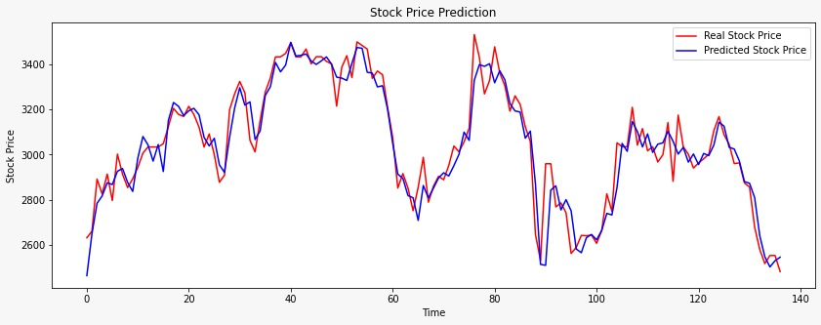
SAMPLE TRENDS
Notes:
Here we see a sample of actual versus predicted trends for a scrip for a period of 14 days using Stockia prototype. As can be seen, the actual and predicted trends are very close to each other.

Slide 18
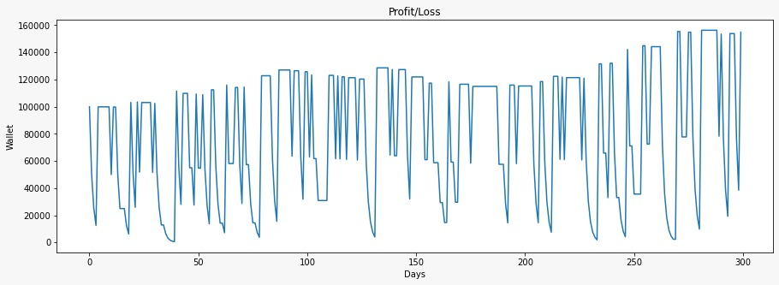
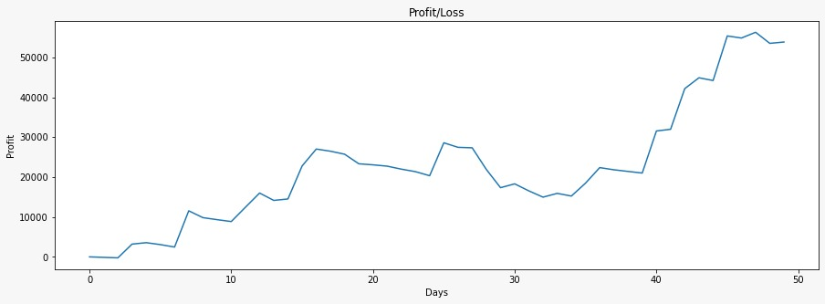
SAMPLE TRENDS
Scrip = HBL
Starting investment = PKR 100,000
Notes:
The upper graph shows the investment growth based on the generated signals for HBL. The starting investment = PKR 100,000. The lower graph shows the profit growth for the same scrip.

Slide 19
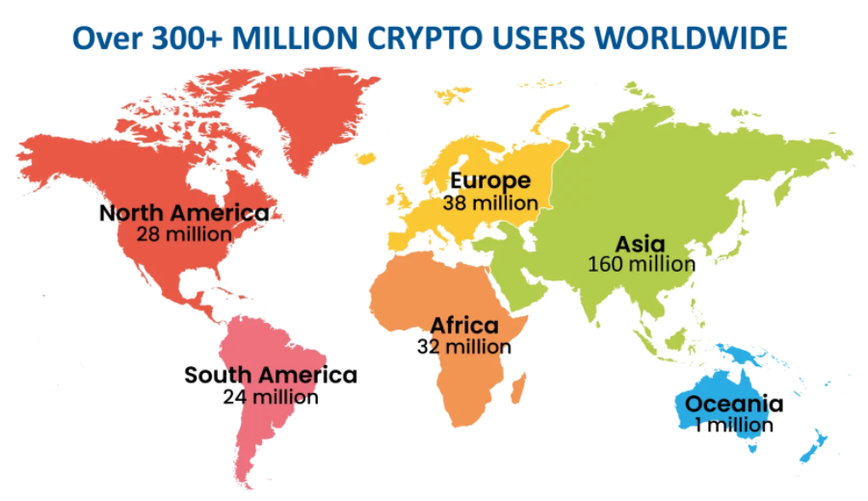
CRYPTO MARKET SIZE
Market Cap. $2.62 Trillion
300 Million Crypto Users Globally
By 2025, 50% of people with a smartphone but without a bank account will use a mobile-accessible cryptocurrency account.
Gartner
Notes:
Crypto Currencies or Digital cryptocurrency is a tradable digital asset or digital form of money, built on block chain technology that only exists online. Cryptocurrencies use encryption to authenticate and protect transactions. In term value of its Market Capitalization is 2.6 $ Trillion and there are over 300 Million users. Asia has the highest No# of Digital Currency Owners/Investors than Europe & USA. Digital Currency has created parallel Economy and enabled the freedom of making transactions between two entities.

Slide 20
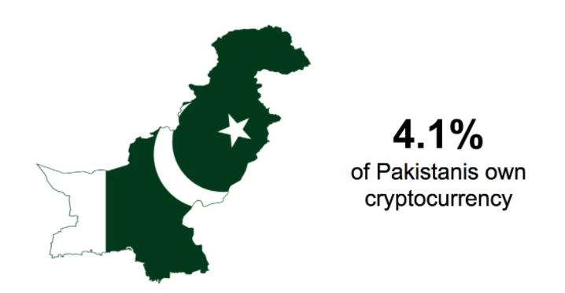
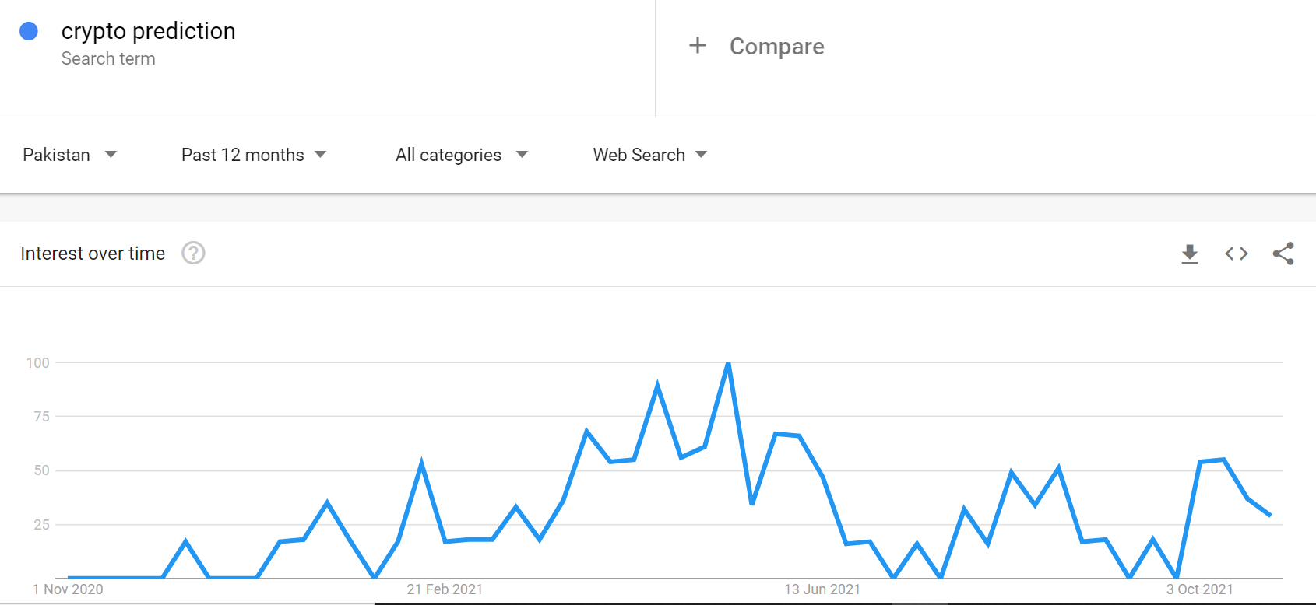
CRYPTO TREND
Over 9 Million Cryptocurrency Owners in Pakistan
Source : https://triple-a.io
Source : https://triple-a.io
Notes:
Pakistan has almost 9 Million user/owners Digital Currency although it is not regulated till now , Pakistan ranked 3rd after Brazil & India in Global Crypto Adoption Index Top 20.

Slide 21
SERVICE OFFERINGS
Volume Sales
Us $ 29 / Month
Notes:
Our offerings 2250 / Month in Pakistan and $29 / Month outside Pakistan and will make agreement with multiple partners to sell our Subscription on 5% commission basis.

Slide 22
TARGET MARKET
S# | Product | Target | Market Size | Expected Revenue per unit | Expected Revenue (up to 2 years) | Expected revenue (6 Years Projection)
1 | Cryptia | International | Total ~ 300 Million Globally Target ~ 11,000 with in 2 years Globally ~ 300 M Target ~ 50,000 | Us$ 29/Month | PKR 52 Million | PKR 328 M
Notes:
The global crypto traders are over 300 million. Our target is to attract around 11,000 subscribers within two years.

Slide 23
REVENUE/INCOME
Product | 1st Year | 2nd Year | 3rd Year | 4th Year | 5th Year | 6th Year
Stockia Revenue | $78,388 | $124,235 | $190,660 | $238,325 | $297,907 | $372,384
Cryptia Revenue | $64,310 | $228,152 | $283,507 | $340,208 | $396,909 | $510,312
Total Revenue | $142,699 | $352,387 | $474,167 | $578,533 | $694,816 | $882,695
Total Cost | $149,667 | $166,750 | $190,193 | $205,862 | $226,398 | $256,208
Gross Profit/Loss | ($6,968) | $185,637 | $283,974 | $372,672 | $468,418 | $626,488
Tax (~25%) | $0 | $46,409 | $70,994 | $93,168 | $117,105 | $156,622
Net Profit | ($6,968) | $139,228 | $212,981 | $279,504 | $351,314 | $469,866
Notes:
Planned to launch Mobile App for Stockia in the 4th quarter of the 1st year from the project commencement date. We plan to launch Cryptia Mobile App in Q2 of 2nd year from the project commencement date. These two products are part of the Startup and their Revenue and Cost will be consolidated. Technology team will be the Core and delivering for both Products , but Marketing , R&D and Business teams will be Product specific.

Slide 24
BUSINESS DEVELOPMENT
Digital Marketing
Engagement with Social Media platforms
Advertisement on Social Media Influencer
Ads Boost up on Social Media
Webinars for awareness
Email Campaigns and Cold Calling
Direct Marketing
Partner / Reseller engagements
Notes:
Digital Marketing is the key to success but it must be aligned with the product to target the real audience and we will engage with partners to reach customers using our connection Stock Market , banks and Brokerages houses.

Slide 25
GO TO MARKET STRATEGY
Product
=
Market Fit
Small & Medium Investors
Investment enthusiastic
Stock Traders
Where to Find
Stock Exchange traders
Brokerage Houses
Banks
Social Media
Product Value
Enhanced Profit
Minimized Risk
Information availability for Decision Making
Channels
Social Media – Facebook Groups
YouTube Video Channels
Free Training Videos
Direct Marketing
Notes:
Our go-to-market strategy consists of reaching stock traders, investors, banks, social media, and direct marketing.

Slide 26
COMPETITIVE LANDSCAPE
PSX Applications | Descriptions | Updated | Downloads | Price | Rating
Investify App | Get quick and real-time access to Pakistan's largest bourse, the Pakistan Stock Exchange (PSX) complete with market data including fundamentals and technical, and your personalized stocks watch list and portfolio tracking tool in this beautifully designed app. Personalize the stocks and data that matters the most to you and access it easily. | June 30 2021 | 100,000 | $4 to $19 | 4.0
KiTS Mobile App | KiTS) Mobile App is a mobile trading application providing Stock rates of registered Stocks in Pakistan Stock Exchange (PSX), with order placement and trade summary features.(KiTS) Mobile App provides you the feature of live Market Watch.KiTS Mobile App is your Smart way of trading ! | June 13 2020 | 50,000 | NA | 3.5
Notes:
For comparison, similar apps are available in market but with different features.

Slide 27
Direktions
SWOT
Notes:
We are a team consisting of highly qualified and experienced professionals with diversified industry and research exposure. The proposed products are low CAPEX continuous business that will be running in multiple countries , we can say it is the business of Future and this one is offering two revenue stream -1 Stockia & -2 Cryptia and both products based on never ending industries.

Slide 28
PRE-SEED FUNDING SO FAR (PROTOTYPE)
More than 10,000 hours of Data Scientists in Research & Development.
More than 4000 hours of Stock Traders for knowledge transfer and testing.
More than $5000 of computing resources

Slide 29
FUNDRAISING (MVP)
Asking for $400,000 (Seed Money) for 2 Products launch as following :
Stockia – Multiple Stock Markets Products & Cryptia – Cryptocurrency Product
Cost | 1st Year | 2nd Year | 3rd Year | 4th Year | 5th Year | 6th Year | Total 6 Years | HR Cost %
Product Development | $52,333.33 | $54,950.00 | $58,796.50 | $64,676.15 | $71,143.77 | $81,815.33 | $383,715.08 | 43.01
Sales & Marketing | $20,000.00 | $21,000.00 | $22,470.00 | $24,717.00 | $27,188.70 | $31,267.01 | $146,642.71 | 16.44
Operations | $32,666.67 | $34,300.00 | $36,701.00 | $40,371.10 | $44,408.21 | $51,069.44 | $239,516.42 | 26.85
Governance (BOD) | $16,666.67 | $17,500.00 | $18,725.00 | $20,597.50 | $22,657.25 | $26,055.84 | $122,202.25 | 13.70
Total HR cost | $121,666.67 | $127,750.00 | $136,692.50 | $150,361.75 | $165,397.93 | $190,207.61 | $892,076.46 | 100.00
 |  |  |  |  |  |  |  | Cost %
Technology Cost (Cloud) | $1,000.00 | $2,000.00 | $2,500.00 | $2,500.00 | $2,500.00 | $2,500.00 | $13,000.00 | 4.29
PC/Laptops | $5,000.00 | $5,000.00 | $5,000.00 | $2,000.00 | $2,000.00 | $2,000.00 | $21,000.00 | 6.93
Office | $2,500.00 | $2,500.00 | $3,500.00 | $3,500.00 | $3,500.00 | $3,500.00 | $19,000.00 | 6.27
Marketing | $15,000.00 | $25,000.00 | $35,000.00 | $40,000.00 | $45,000.00 | $50,000.00 | $210,000.00 | 69.31
GRC | $1,500.00 | $1,500.00 | $2,500.00 | $2,500.00 | $3,000.00 | $3,000.00 | $14,000.00 | 4.62
Licensing | $2,000.00 | $2,000.00 | $3,000.00 | $3,000.00 | $3,000.00 | $3,000.00 | $16,000.00 | 5.28
Misc Cost | $1,000.00 | $1,000.00 | $2,000.00 | $2,000.00 | $2,000.00 | $2,000.00 | $10,000.00 | 3.30
Total Other Cost | $28,000 | $39,000.00 | $53,500.00 | $55,500.00 | $61,000.00 | $66,000.00 | $303,000.00 | 100.00
Total | $149,667 | $166,750 | $190,193 | $205,862 | $226,398 | $256,208 | $1,195,076.46

Slide 30
OFFER
15 % of Equity

